Slide 1
Chapter 2: Personality and Sport
C H A P T E R
1
Personality and Sport

Slide 2
Session Outline
What is personality and why is it important?
What makes up personality?
Major approaches to understanding personality
Measuring and assessing personality
Dos and don’ts in personality testing
(continued)

Slide 3
Session Outline (continued)
Selected findings in personality research
Cognitive strategies and athletic success
Your role in understanding personality

Slide 4
Personality and Its Structure
Personality: The characteristics or blend of characteristics that make a person unique
The structure of personality:
  Psychological core
  Typical responses
  Role-related behavior

Slide 5
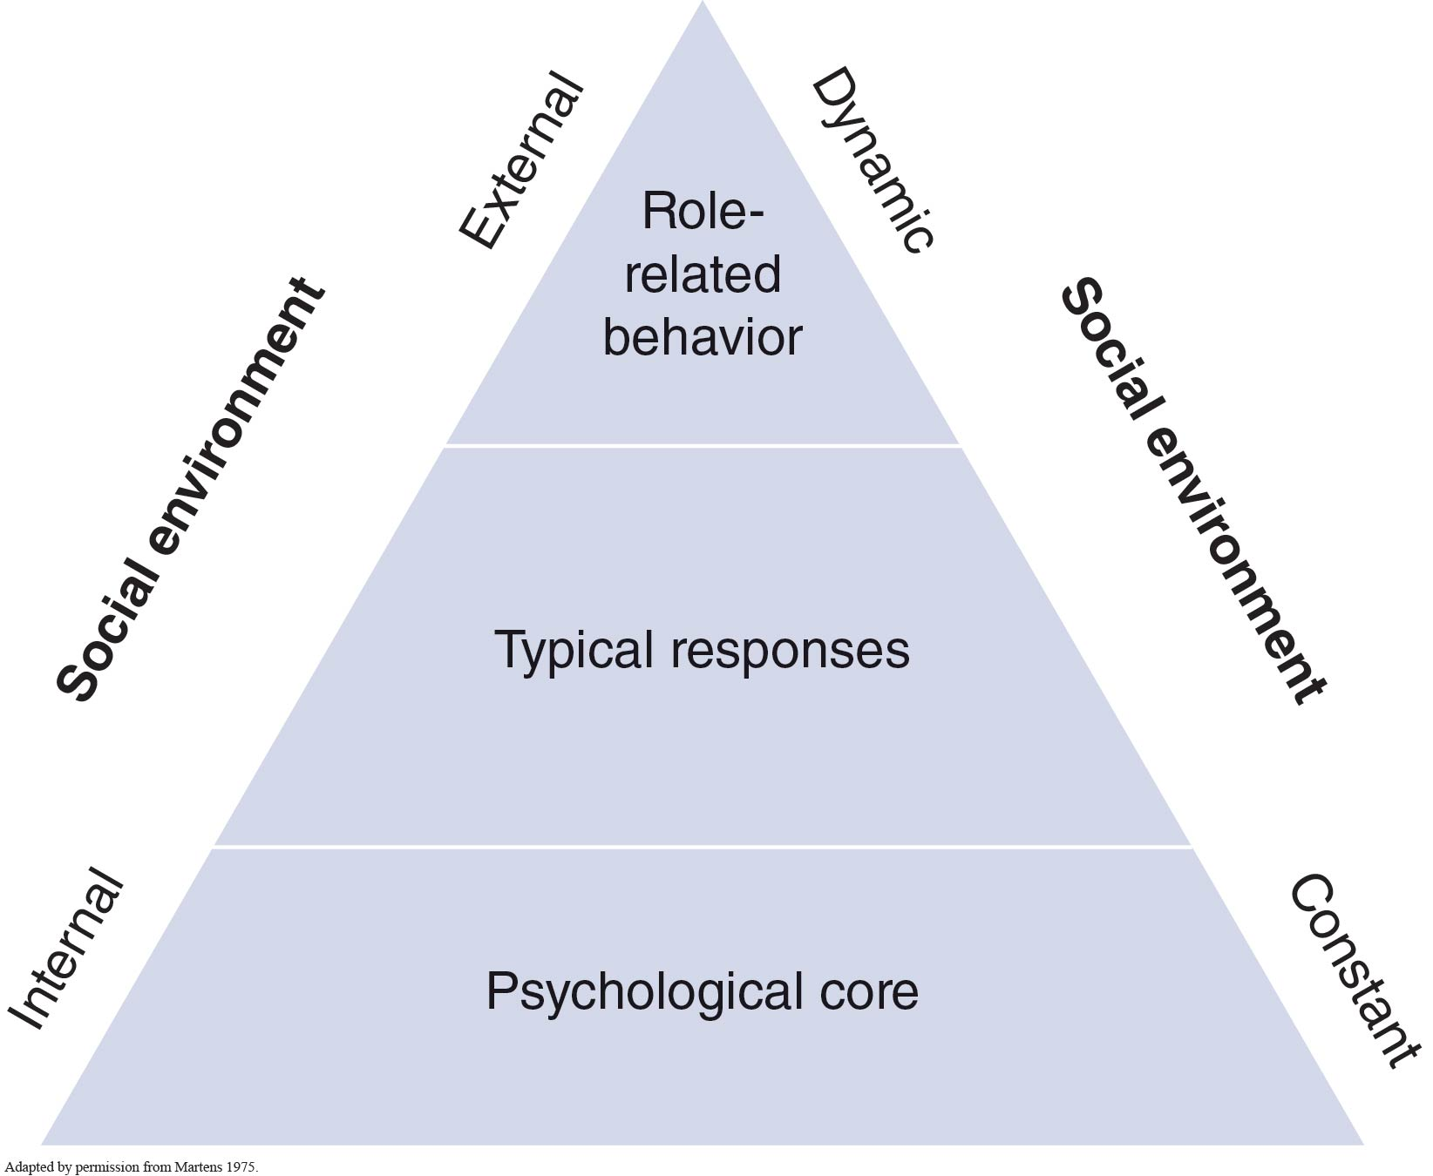
Figure 2.1

Slide 6
Psychological Core
The most basic and deepest attitudes, values, interests, motives, and self-worth of a person—the real person
Example: A person’s religious values

Slide 7
Typical Responses
The way one typically adjusts or responds to the environment
Example: Being happy-go-lucky, shy

Slide 8
Role-Related Behavior
How one acts in a particular social situation
Example: Behavior as a student, parent, or friend

Slide 9
Approaches to Understanding Personality
Psychodynamic approach
Trait approach
Situational approach
Interactional approach
Phenomenological approach

Slide 10
Psychodynamic Approach
Behavior is determined by several unconscious, constantly changing factors that often conflict with one another.
Emphasis is placed on understanding the person as a whole rather than identifying isolated traits.

Slide 11
Trait Approach
Behavior is determined by relatively stable traits that are fundamental units of personality.
These traits predispose one to act in a certain way, regardless of the situation.

Slide 12
Big 5 Model of Personality Components
Neuroticism
Extroversion
Openness to experience
Agreeableness
Conscientiousness

Slide 13
Situational Approach
Behavior is determined largely by the situation or environment.
The situation is a more important determinant of behavior than particular personality traits.
The situational approach is not as widely embraced by most sport psychologists.

Slide 14
Interactional Approach
Behavior is determined by both the person and the situational factors as well as by their interaction.
The majority of contemporary sport and exercise psychologists favor the interactional approach.

Slide 15
Phenomenological Approach
Behavior is best determined by accounting for situational and personal characteristics.
A person’s understanding and interpretation of one’s self and environment are critical.
The phenomenological view is often stressed by today’s sport psychologists.

Slide 16
Research Support for Psychodynamic Approach
Current impact: Has little influence and hasn’t been adopted by most contemporary sport psychologists.
Weakness: Focuses almost entirely on internal determinants of behavior, giving little attention to the social environment.
Contribution: Has increased awareness that unconscious determinants of behavior exist.

Slide 17
Research Support for Trait Approach
Current impact: Has little influence.
Weakness: Knowing traits will not always help predict behavior in particular situations.
Contribution: Emphasizes the importance of traits and the measurement of such dispositions.

Slide 18
Research Support for Situational Approach
Current impact: Has little influence.
Weakness: Situation will not always influence individual behavior.
Contribution: Emphasizes the importance of the situation.

Slide 19
Research Support for Interactional Approach
Current impact: Has considerable influence and has been adopted by most contemporary sport psychologists.
Weakness: None.
Contribution: Emphasizes the consideration of both trait and situational variables and their interaction.

Slide 20
Research Support for Phenomenological Approach
Current impact: Has considerable influence and has been adopted by many contemporary sport psychologists.
Weakness: None.
Contribution: Emphasizes the contribution of a person’s interpretation of one’s self and environment while considering both trait and situational variables and their interaction.

Slide 21
Measuring Personality:
Traits and States
Measure both traits and states.
A trait is a typical style of behavior.
State is the situation’s effect on behavior—a “right now” feeling that can change from moment to moment.

Slide 22
Measuring Personality
There are general versus situation-specific (sport-specific) measures.
Situation-specific trait tests predict behavior more accurately than do general trait measures.
(continued)

Slide 23
Measuring Personality (continued)
It is often more effective to compare personality test scores to a person’s own previous test results than to group norms.
Projective tests are interesting but difficult to score.

Slide 24
Your Role in Understanding Personality
Consider both personality traits and situations.
Be an informed consumer.
Be a good communicator.
Be a good observer.
Be knowledgeable about mental strategies.

